Slide 1
Development of a Diagonal Isometric Tensor Network Algorithm
Masters thesis
Benjamin Sappler
Supervisor: Frank Pollmann
Second corrector: Michael Knap

Slide 2
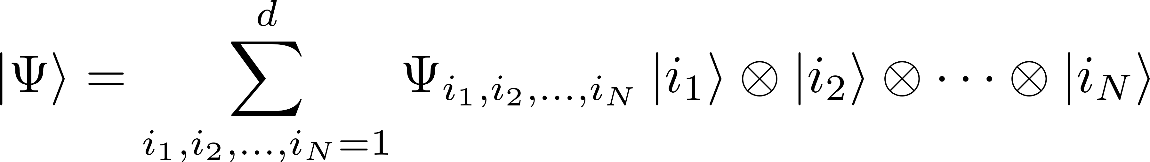
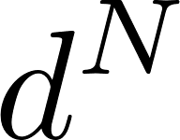
Simulation of QMB systems
Fully describe wavefunction: parameters!
Approximations are needed!

Slide 3
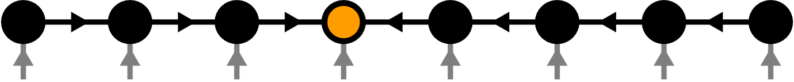
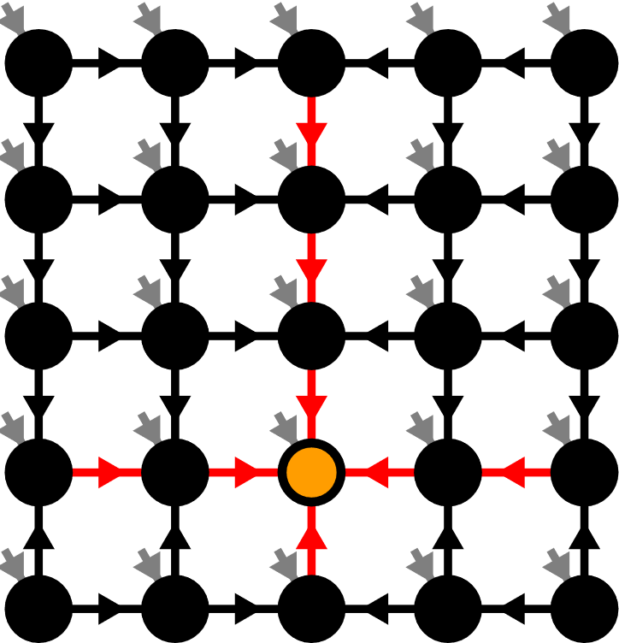
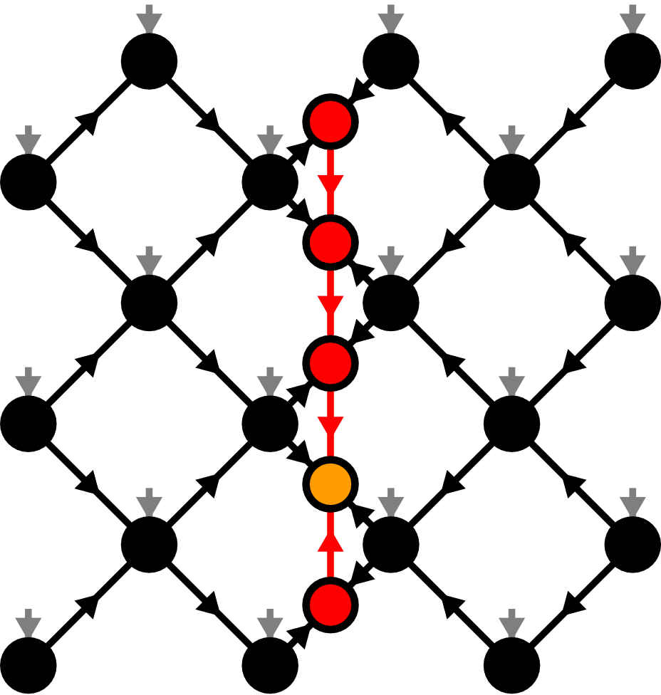
Contents
Matrix Product States (MPS)
Isometric Tensor Product States (isoTPS)
Alternative canonical form

Slide 4
Contents
Matrix Product States (MPS)
Isometric Tensor Product States (isoTPS)
Alternative canonical form

Slide 5

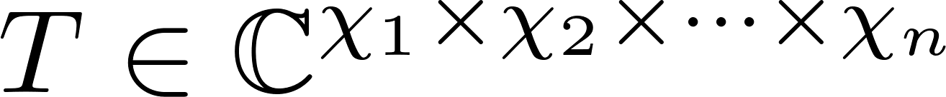
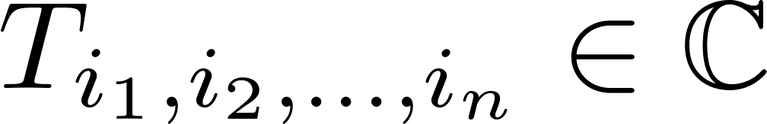
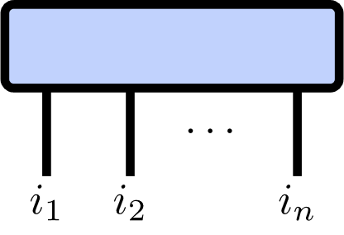
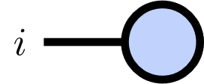
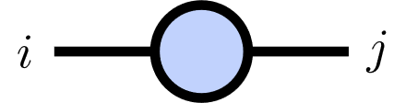
Tensor Networks
Tensor of rank :

Slide 6
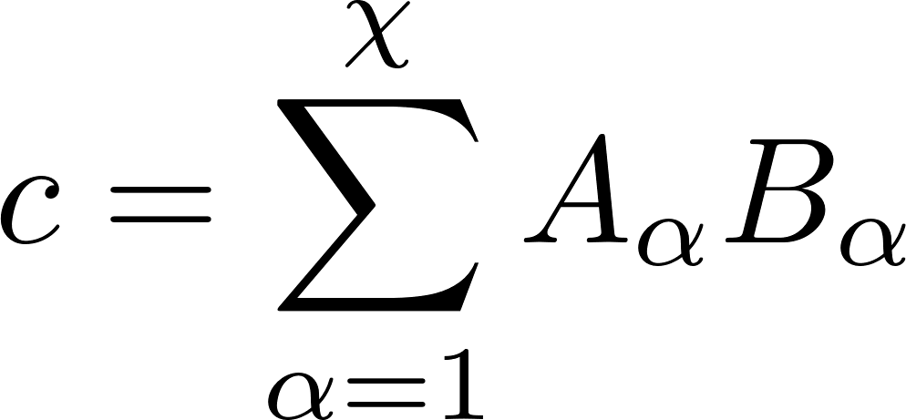
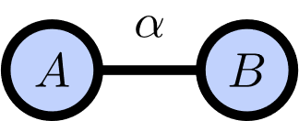
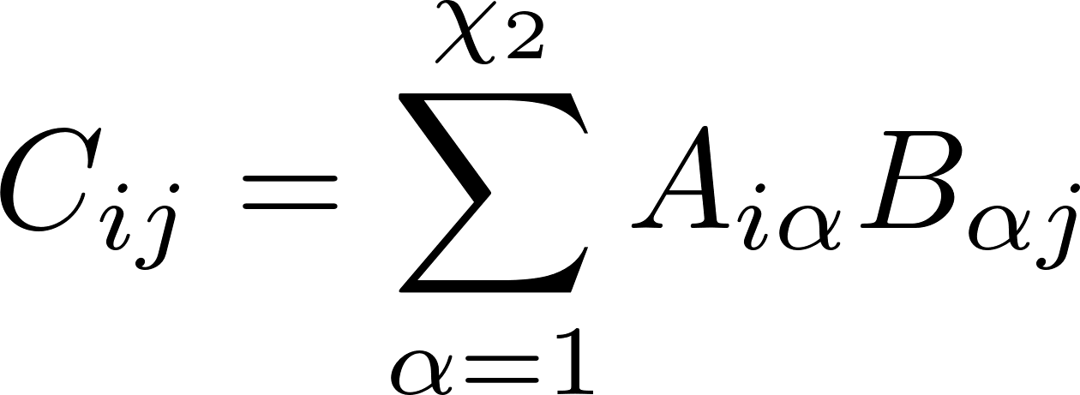
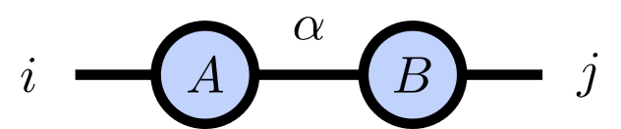
Index Contractions
Scalar product:
Matrix product:

Slide 7
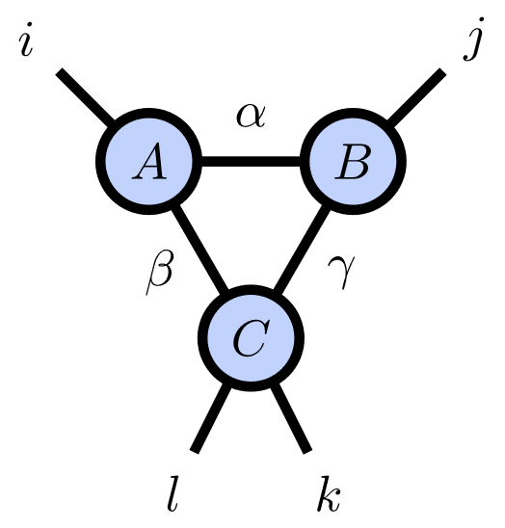
Index Contractions

Slide 8
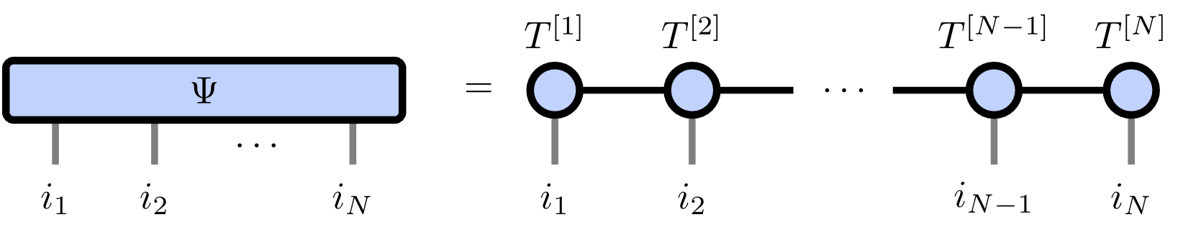
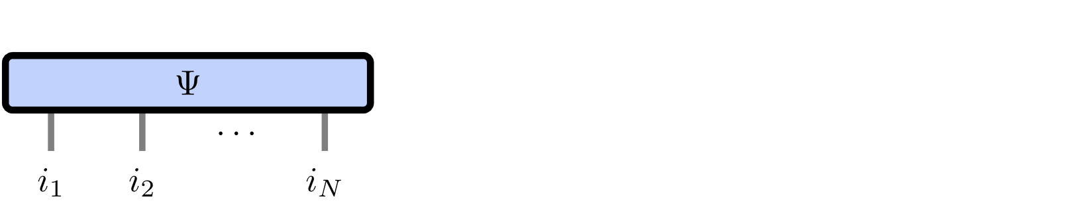
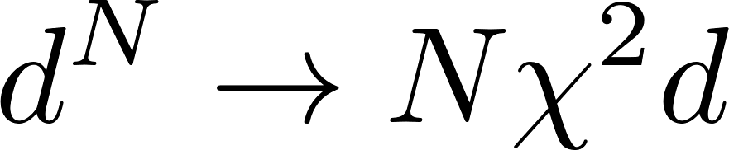
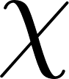
Matrix Product States
Number of parameters:
Represents area law states

Slide 9
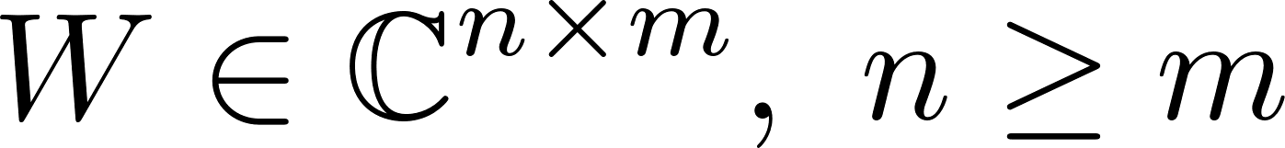
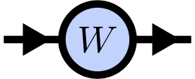
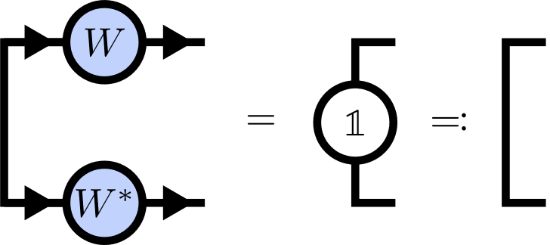
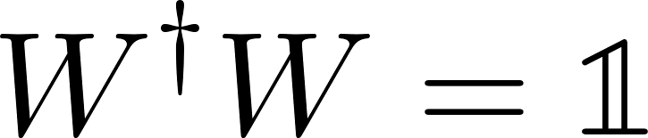
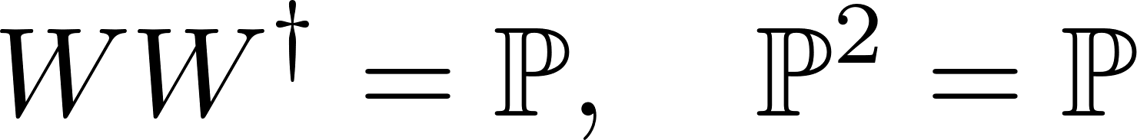
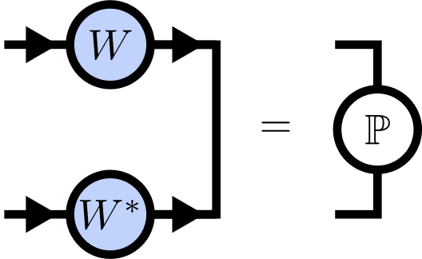
Isometries
Isometry:
Isometry condition:

Slide 10
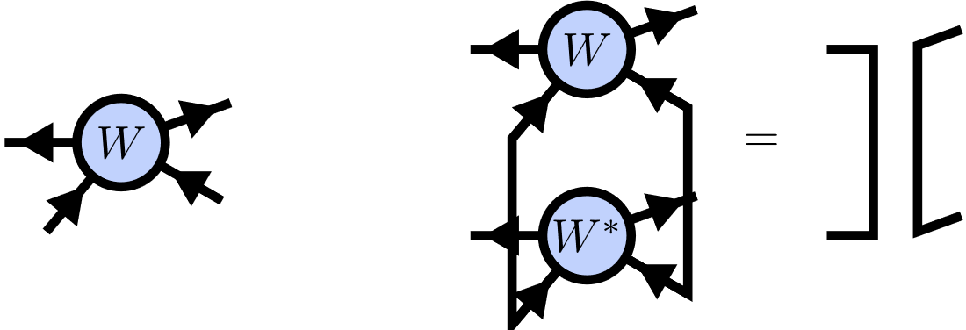
Isometric Tensors

Slide 11
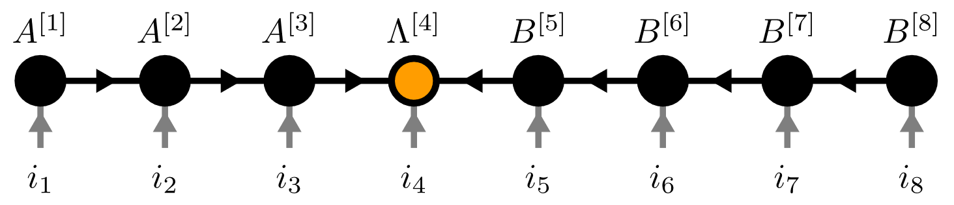
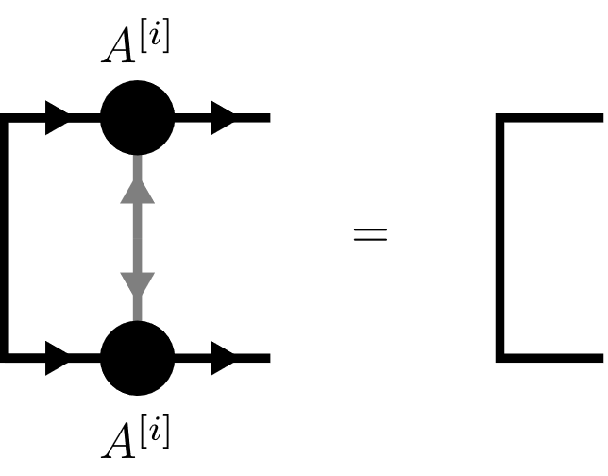
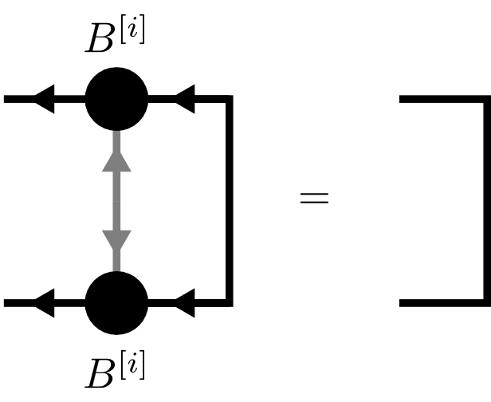
Canonical Form

Slide 12
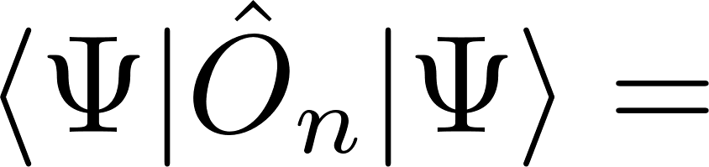
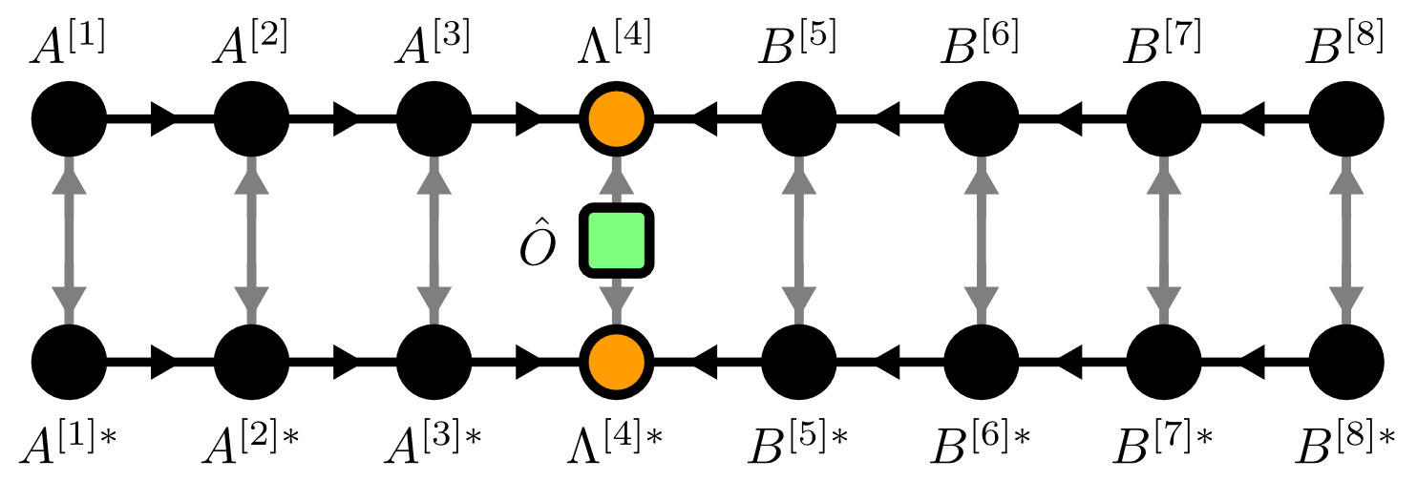

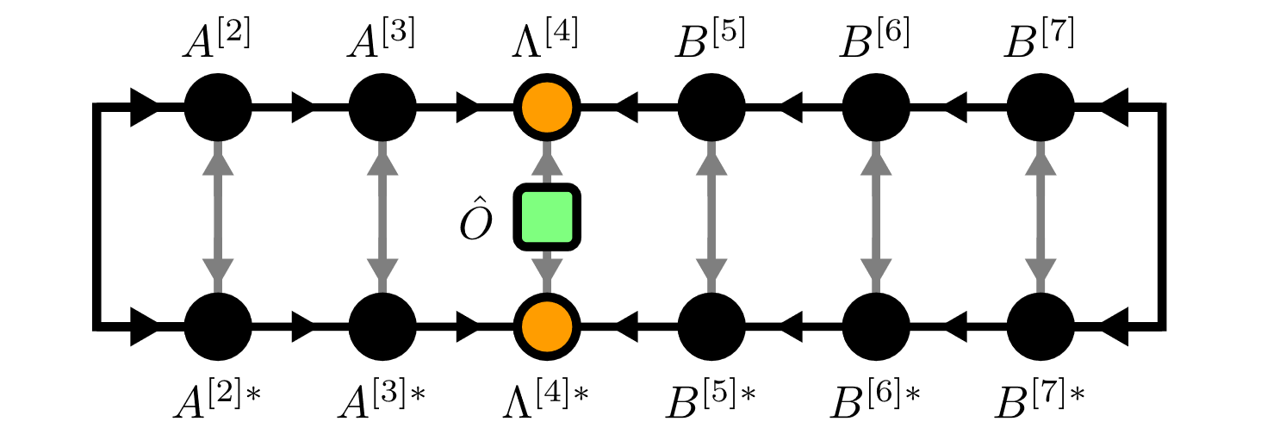
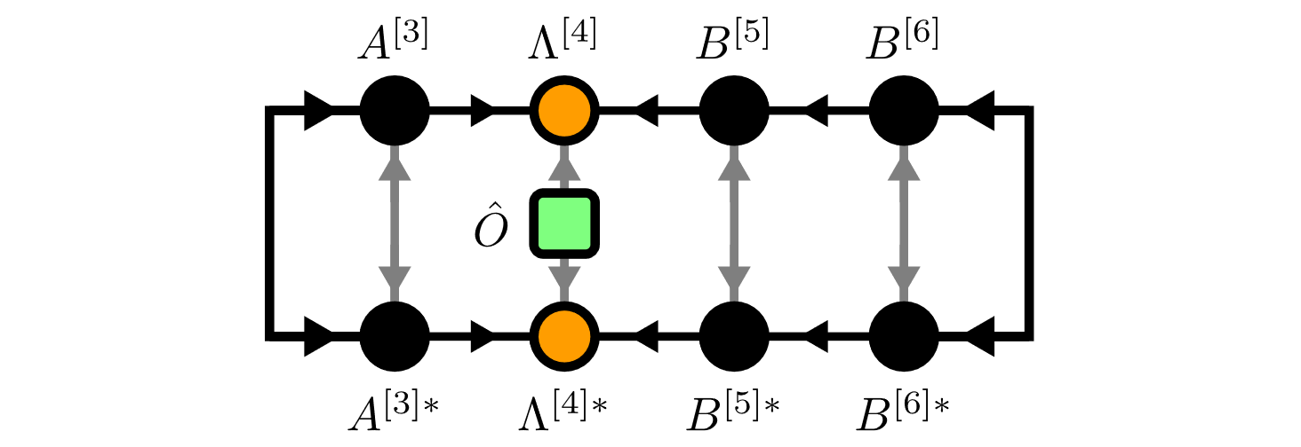

Local Expectation Values

Slide 13
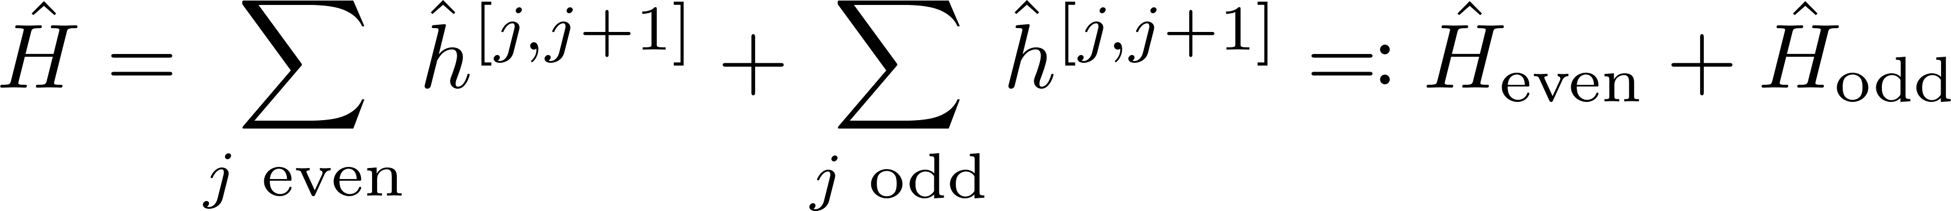
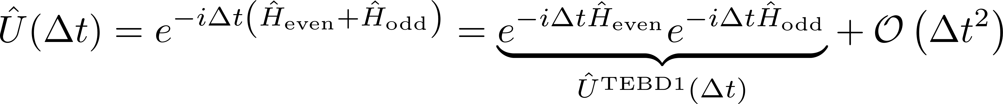
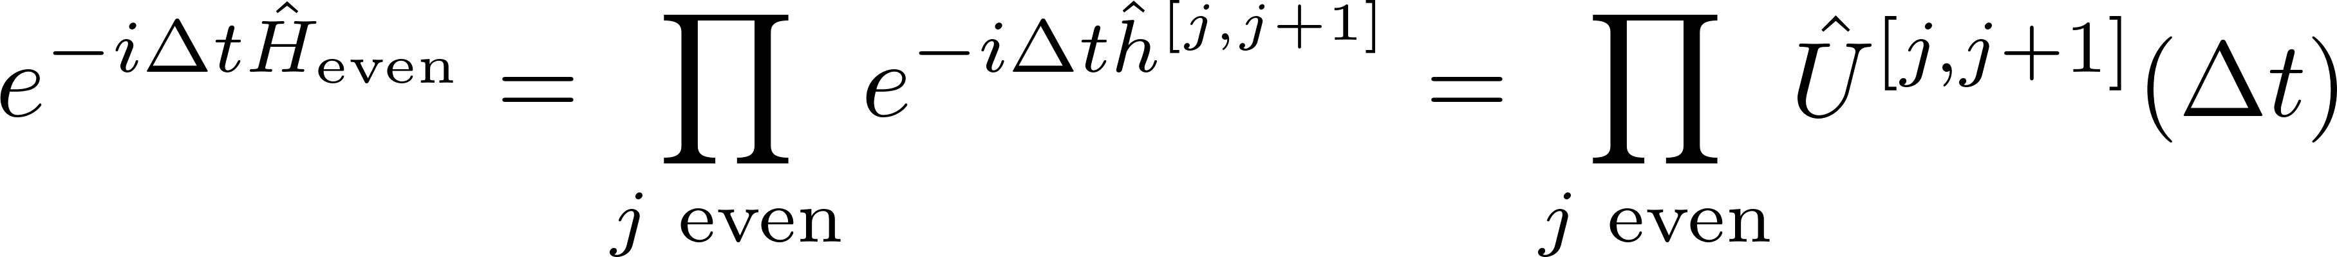
Time Evolving Block Decimation (TEBD)
Schrödinger equation:
Hamiltonian
Suzuki-Trotter decomposition:

Slide 14
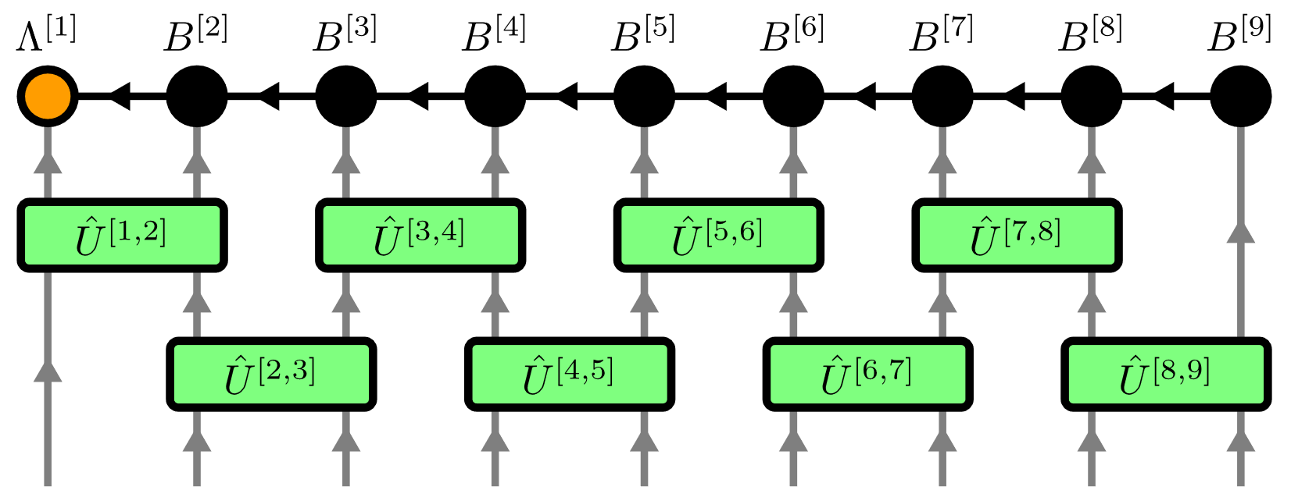
Time Evolving Block Decimation (TEBD)

Slide 15
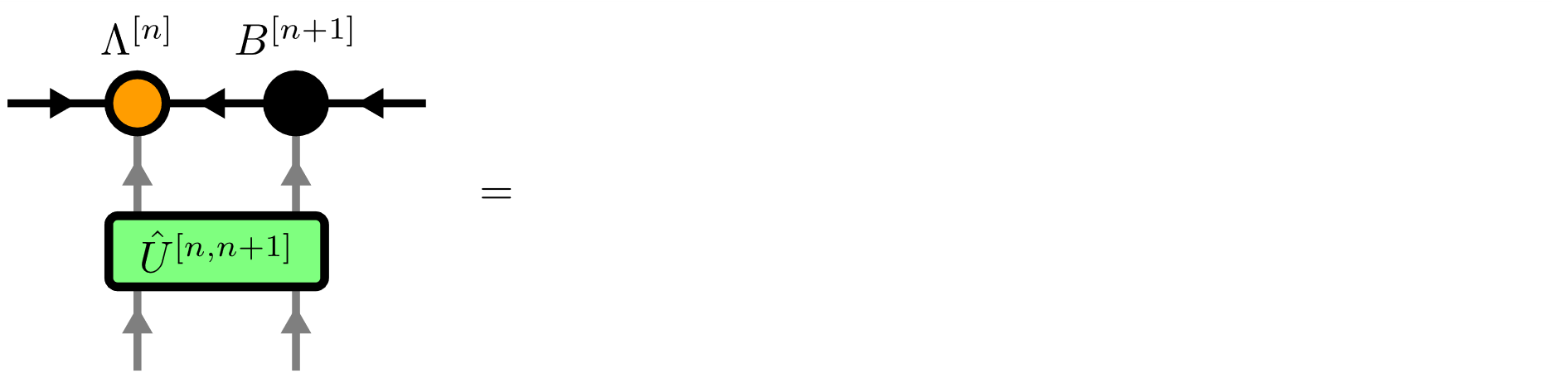
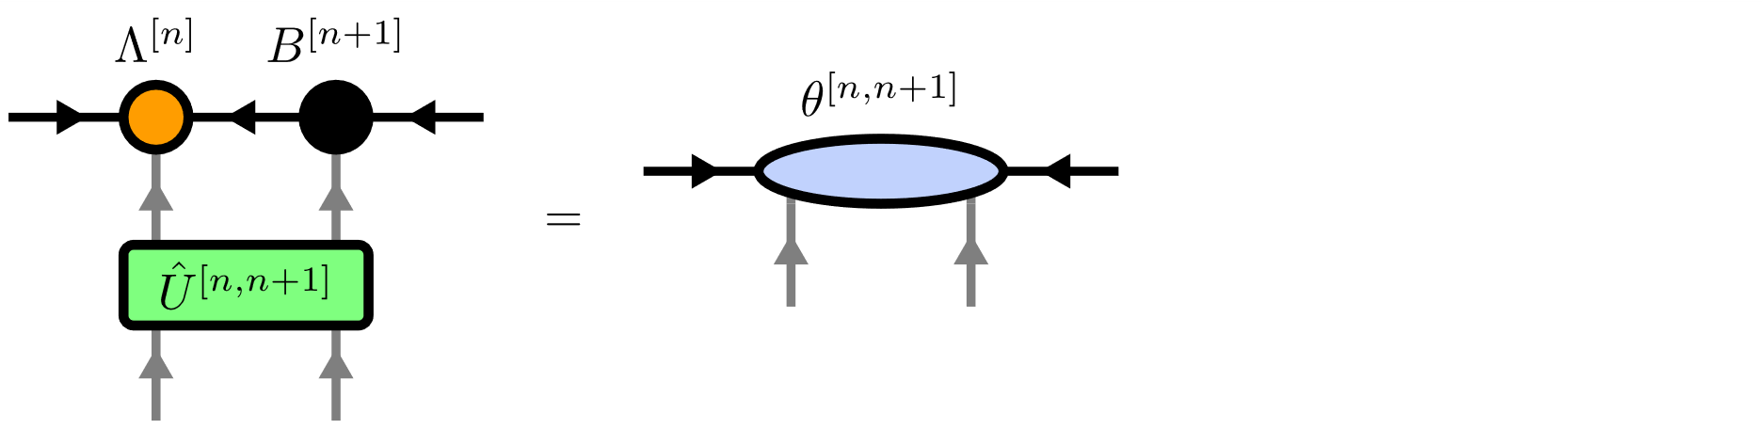
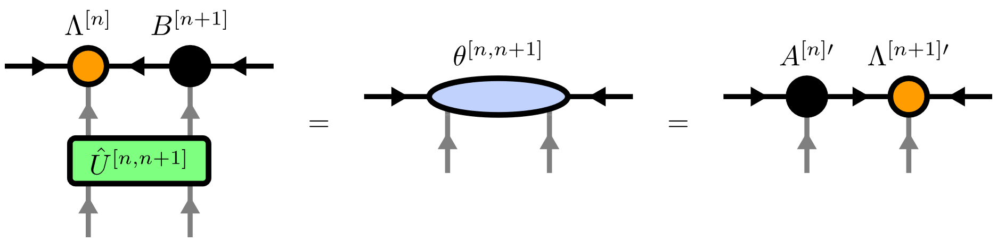
Time Evolving Block Decimation (TEBD)

Slide 16
Contents
Matrix Product States (MPS)
Isometric Tensor Product States (isoTPS)
Alternative canonical form

Slide 17
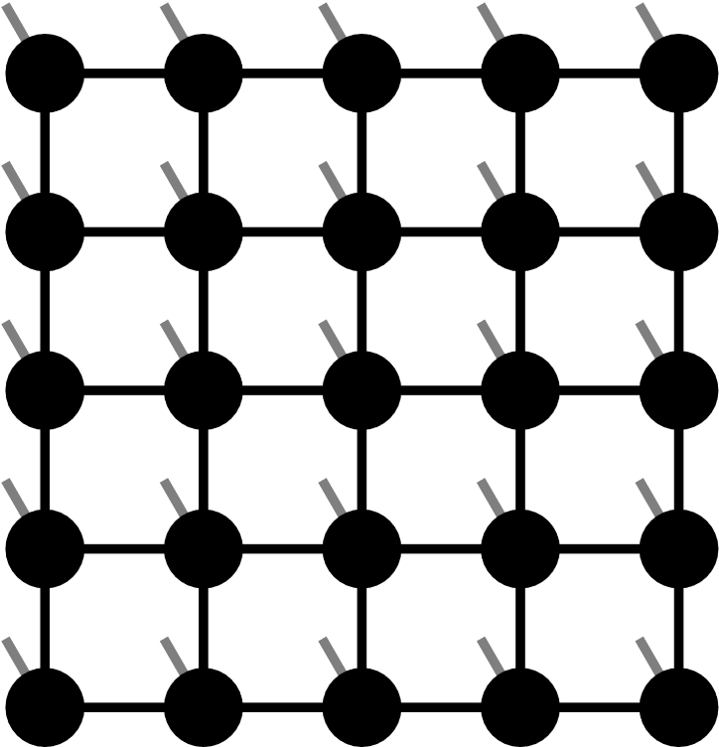

Projected Entangled Pair States (PEPS)

Slide 18
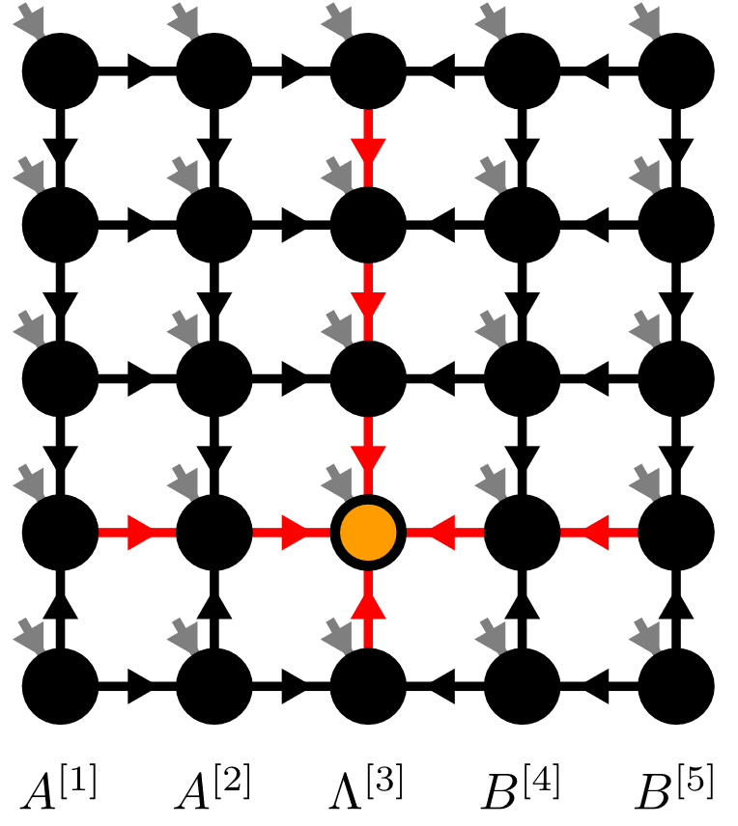
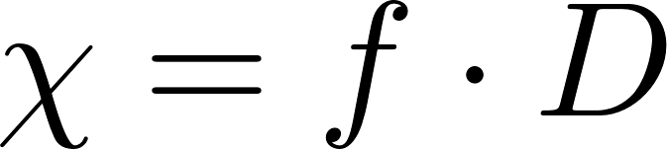
Isometric Tensor Product State

Slide 19
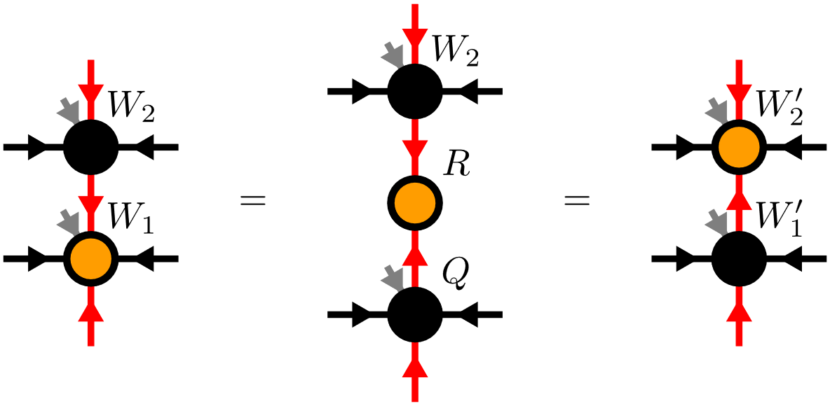
Moving the Orthogonality Center

Slide 20
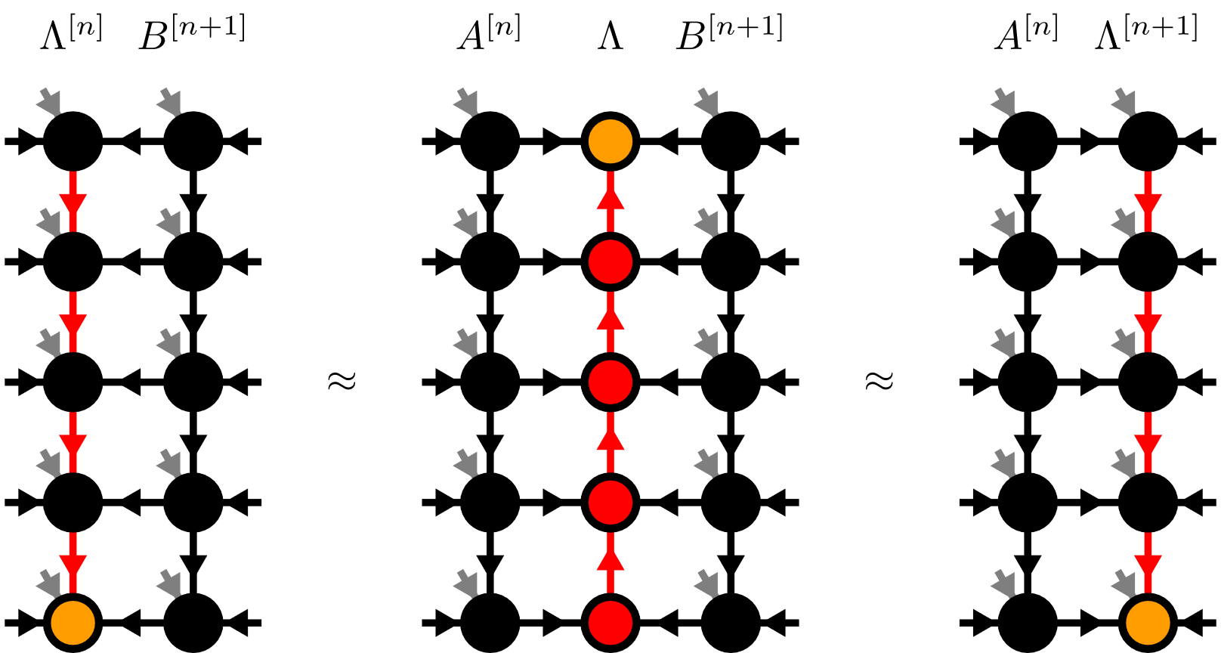
Moving the Orthogonality Hypersurface

Slide 21
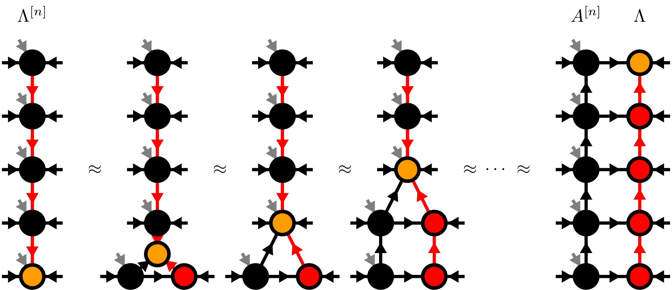
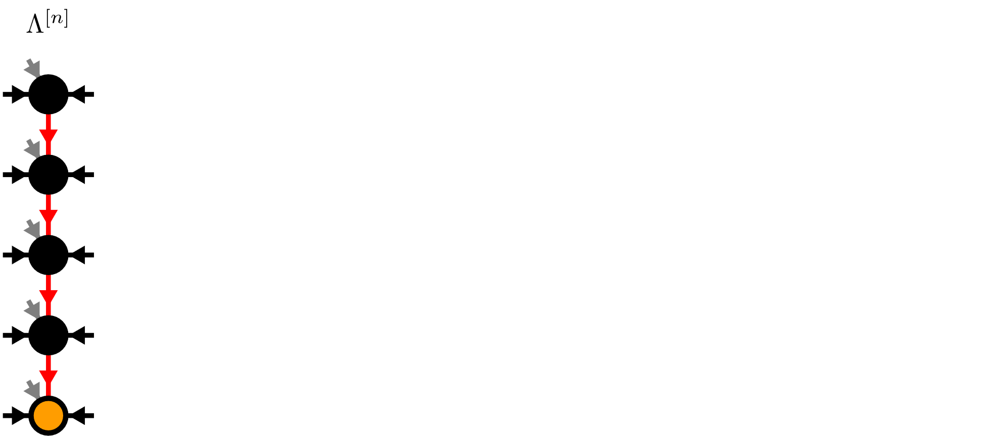
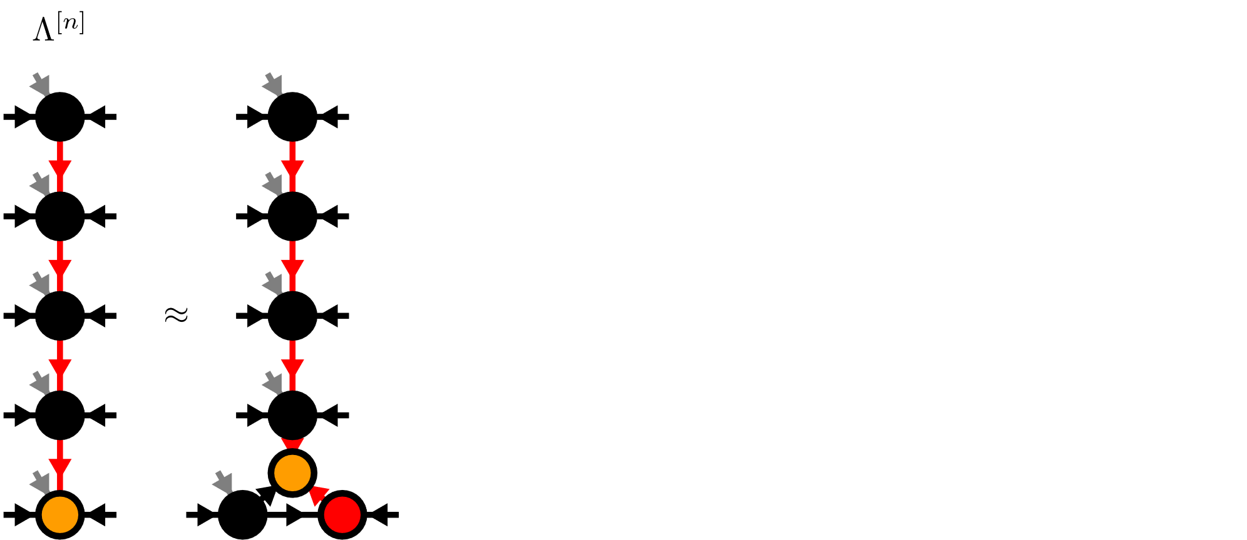
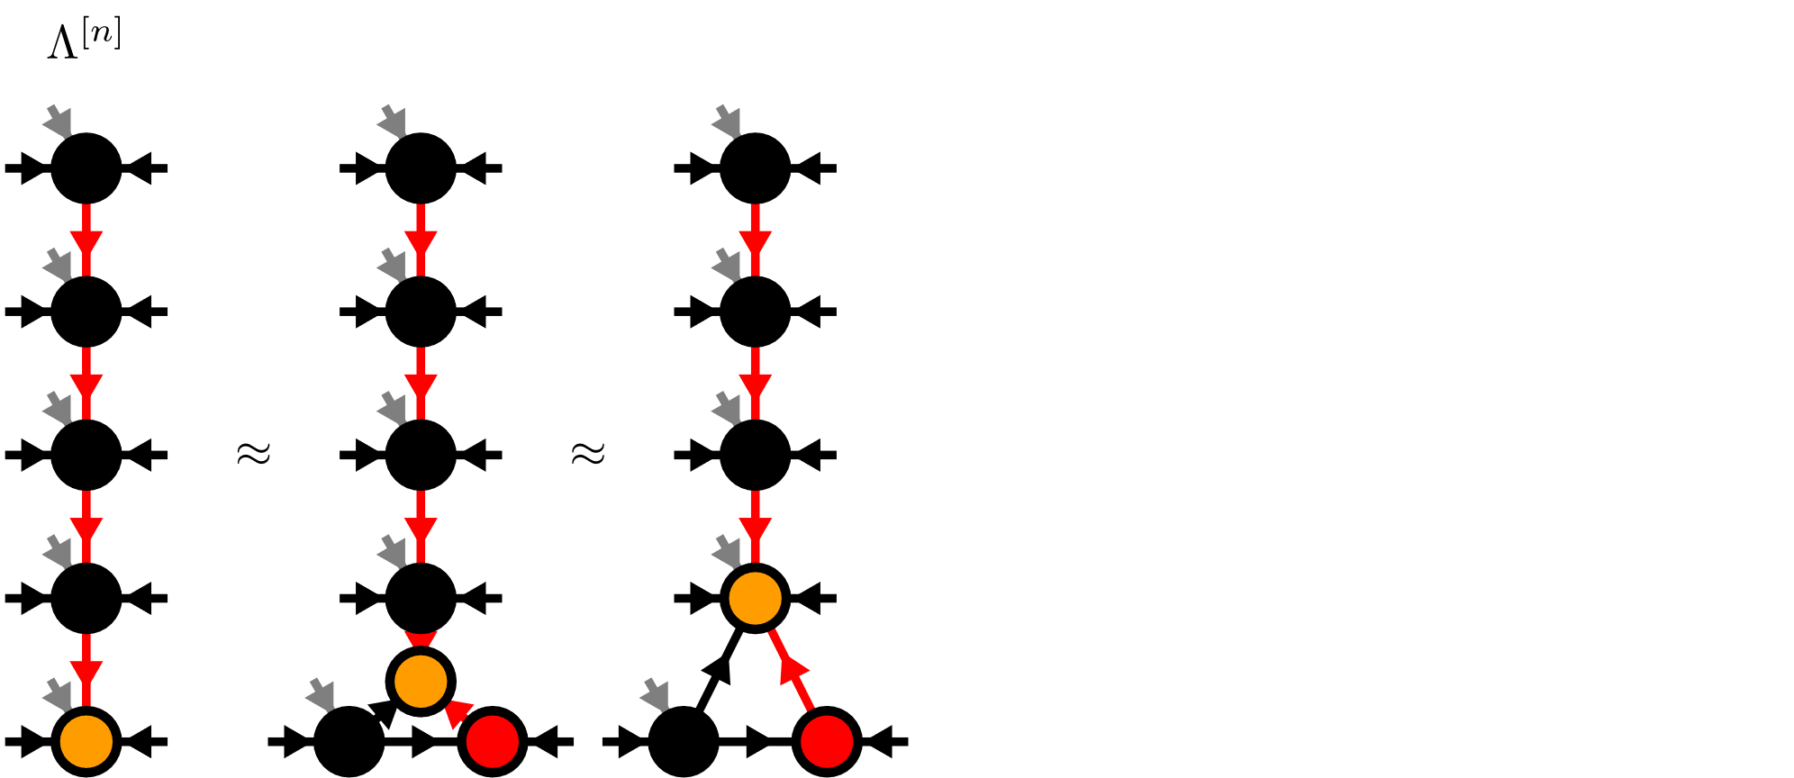
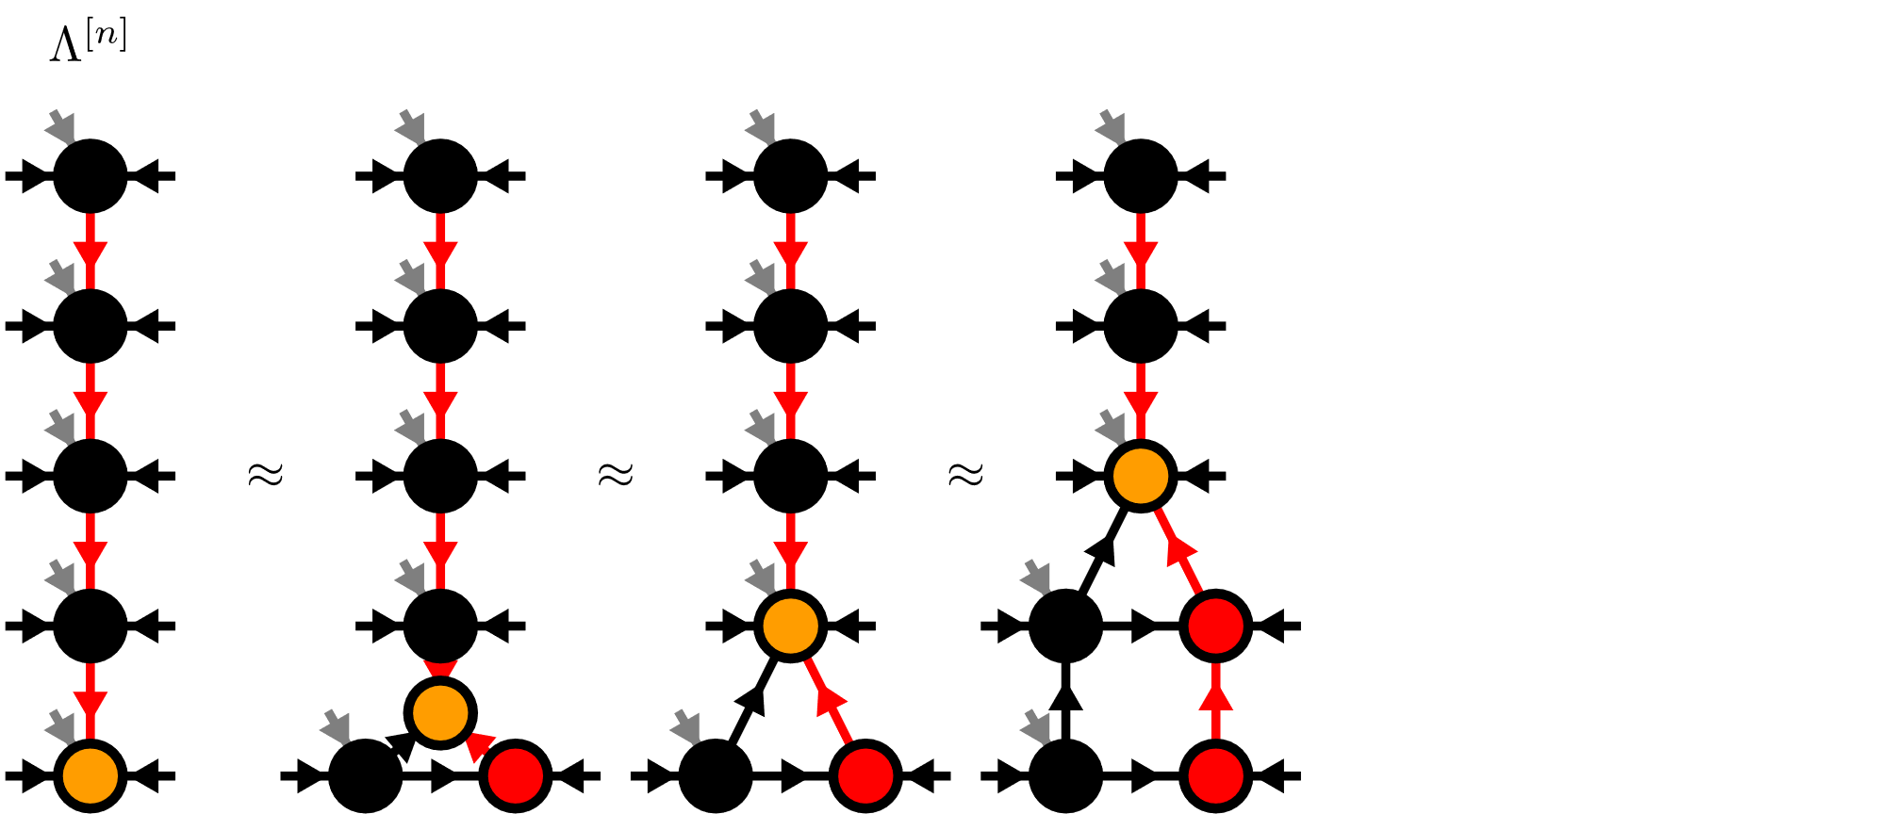
Moses-Move (MM)

Slide 22




Moses-Move (MM) – Tripartite Decomposition

Slide 23


Algorithms on isoTPS
TEBD:
DMRG:
But no generalized eigenvalue problem!

Slide 24
Contents
Matrix Product States (MPS)
Isometric Tensor Product States (isoTPS)
Alternative canonical form

Slide 25

Alternative canonical form

Slide 26



Local Expectation Values

Slide 27






Moving the orthogonality hypersurface

Slide 28



Yang-Baxter (YB) Move
YB Error

Slide 29

Yang-Baxter (YB) Move
Constrained optimization problem
Two algorithms:
Variational optimization with local updates
Tripartite decomposition using SVD + disentangling

Slide 30


YB-move: Variational optimization

Slide 31

YB-move: Variational optimization

Slide 32






YB-move: Tripartite decomposition

Slide 33

Disentangling procedure

Slide 34




Disentangling procedure
Cost functions:
Truncation error
Renyi-entropy
with

Slide 35




Renyi-2 disentangling
Cost function:
Evenbly-Vidal algorithm:
maximize

Slide 36

Renyi-2 disentangling

Slide 37




Riemannian optimization
No easy tensor network form for cost functions
Use Riemannian optimization!

Slide 38


Riemannian optimization
Computing Gradient costs

Slide 39




Approximate Gradients

Slide 40

Approximate Gradients

Slide 41


TEBD: Local updates
Apply local bond operator:
Optimization problem:

Slide 42


TEBD: Local updates

Slide 43







TEBD1

Slide 44






TEBD2

Slide 45


Transverse Field Ising (TFI) model
Critical field
Imaginary TEBD:
Best results:

Slide 46



Comparing YB-move algorithms

Slide 47



Comparing YB-move algorithms

Slide 48


Comparing YB-move algorithms

Slide 49


TEBD1 vs TEBD2

Slide 50




Larger lattices

Slide 51



Larger lattices

Slide 52

Real-time evolution: Global quench

Slide 53


Summary & Outlook
Alternative canonical form
YB-move:
Easily generalizable to other lattices
TEBD algorithm
Outlook:
DMRG?
Thermodynamic limit?
GPUs?

